Slide 1
Handling Events in React
React Main Concept #6

Slide 2
Syntactic Differences Compared with Handling DOM Elements
DOM
React
Events are lowercase
Event handlers are passed as strings.
Example:
<button onclick=“helloWorld()"> Hello World!</button>
Events are camelCase
Event handlers are passed as functions.
Example:
<button onClick={helloWorld}> Hello World! </button>

Slide 3
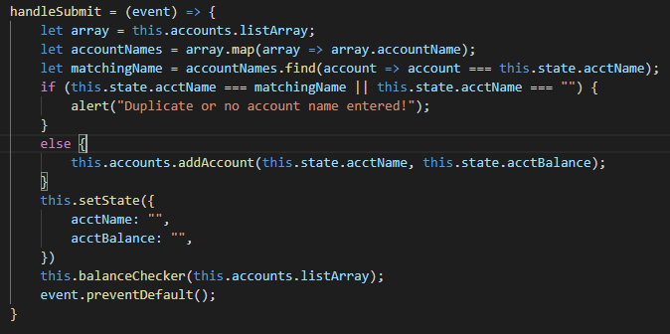
Prevent Default
All native HTML elements come with their internal native behaviour.
In React, you can’t return false to prevent a default behaviour. If there is a default behaviour that you are trying to prevent, you must call preventDefault() explicitly.
In the following example from when I migrated myAccounts exercise, preventDefault() was used to prevent the default behaviour of a form submit button, which would normally refresh the browser when it is clicked.
Notes:
If something is “implicit”, it means that the JS engine does it, if it’s “explicit”, it means the user must do it.

Slide 4

All Around Good Dude, Tyler Armitage

Slide 5
AGENT OF REACT PRESENTATION CHAOS

Slide 6
Binding “This”

Slide 7
Passing Arguments to Event Handlers

